Slide 1
Preventing Prescription Opioid Misuse
Texas Targeted Opioid Response
PRESENTERS NAME

Slide 2
Presenting Organization
PRESENTED BY
Texas Targeted Opioid Response

Slide 3
Agenda
Opioid Crisis in Texas
What Are Opioids?
What Are the Risks?
Reasons Not to Use Opioids
Actions You Can Take

Slide 4
“Nearly one in five Texas high school students have taken prescription drugs without a doctor’s prescription.”
- PPRI, Texas School Survey of Drug and Alcohol Use, 2020.

Slide 5
Opioid Crisis in Texas
01

Slide 6
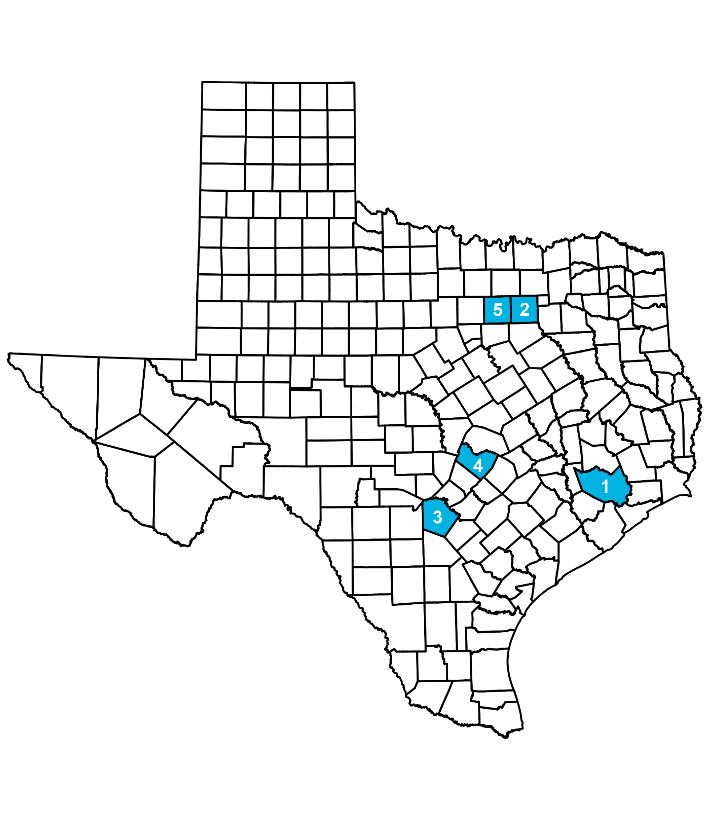
One in four Texans has experienced an opioid overdose or knows someone who has.
Top five counties in Texas with the highest counts of opioid overdose deaths as of 2019:
Harris County
Dallas County
Bexar County
Travis County
Tarrant County
Prescription drug overdose is a leading cause of maternal mortality in Texas (Texas Health and Human Services).
Nearly one in five Texas high school students have taken prescription drugs without a doctor’s prescription (Texas Health and Human Services).
In 2020, nearly 92,000 people died from drug overdoses, making it a leading cause of injury-related death in the United States. Of those deaths, nearly 75% involved a prescription or illicit opioid. Drug overdose deaths continue to increase in the United States (Centers for Disease Control and Prevention).

Slide 7
Regional Data
REGION NAME
You can present regional data specific to your organizations area here.
See HHS Texas Health Data: https://healthdata.dshs.texas.gov/dashboards/drugs-and-alcohol/opioids/
Titles and subtitles can be changed

Slide 8
What Are Opioids?
02

Slide 9
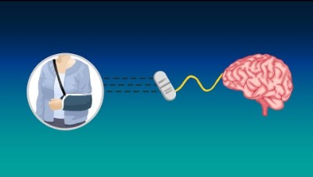
INSERT VIDEO: SEE HOW PRESCRIPTION OPIOIDS WORK

Slide 10
Prescribed to help with pain from
Prescription opioids are a class of powerful pain management medications.
A serious injury
Surgery
C-section birth
Cancer and more
Some examples of brand names include
Lortab
Ultram
Tylenol with Codeine
Percocet
Vicodin
OxyContin

Slide 11
What Are The Risks?
03

Slide 12
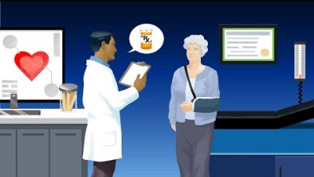
INSERT VIDEO: LEARN THE RISKS OF OPIOID MISUSE

Slide 13
Your body and brain quickly get used to the medication
Your body can become dependent on prescription opioids after just seven days, potentially setting you on a path toward addiction.
The prescribed amount becomes less and less effective.
You would need more to manage the pain, which increases the risk of misuse and overdose.
Look for signs of withdrawal after physical dependence
Insomnia
Anxiety
Nausea
Muscle aches
Restlessness

Slide 14
Misuse is taking opioids any way other than what is prescribed by a doctor
Opioids are powerful medications for people with severe pain but misusing them can be dangerous or even deadly.
Taking more than prescribed
Taking them without a prescription
Taking more than necessary can lead to dangerous side effects
Over sedation
Slowed breathing
Overdose
Death

Slide 15
Overdose can happen when a person
Learn the signs of an overdose.
Intentionally or unintentionally takes too much of an opioid.
Mixes opioids with other drugs or alcohol at a level that is toxic to the body
Signs of an overdose
Very small pupils
Unconscious
Face is extremely pale or feels clammy to the touch
Body goes limp
Fingernails or lips have a purple or blue color
Vomiting or making gurgling noises
Cannot be awakened or are unable to speak
Breathing or heartbeat slows or stops

Slide 16
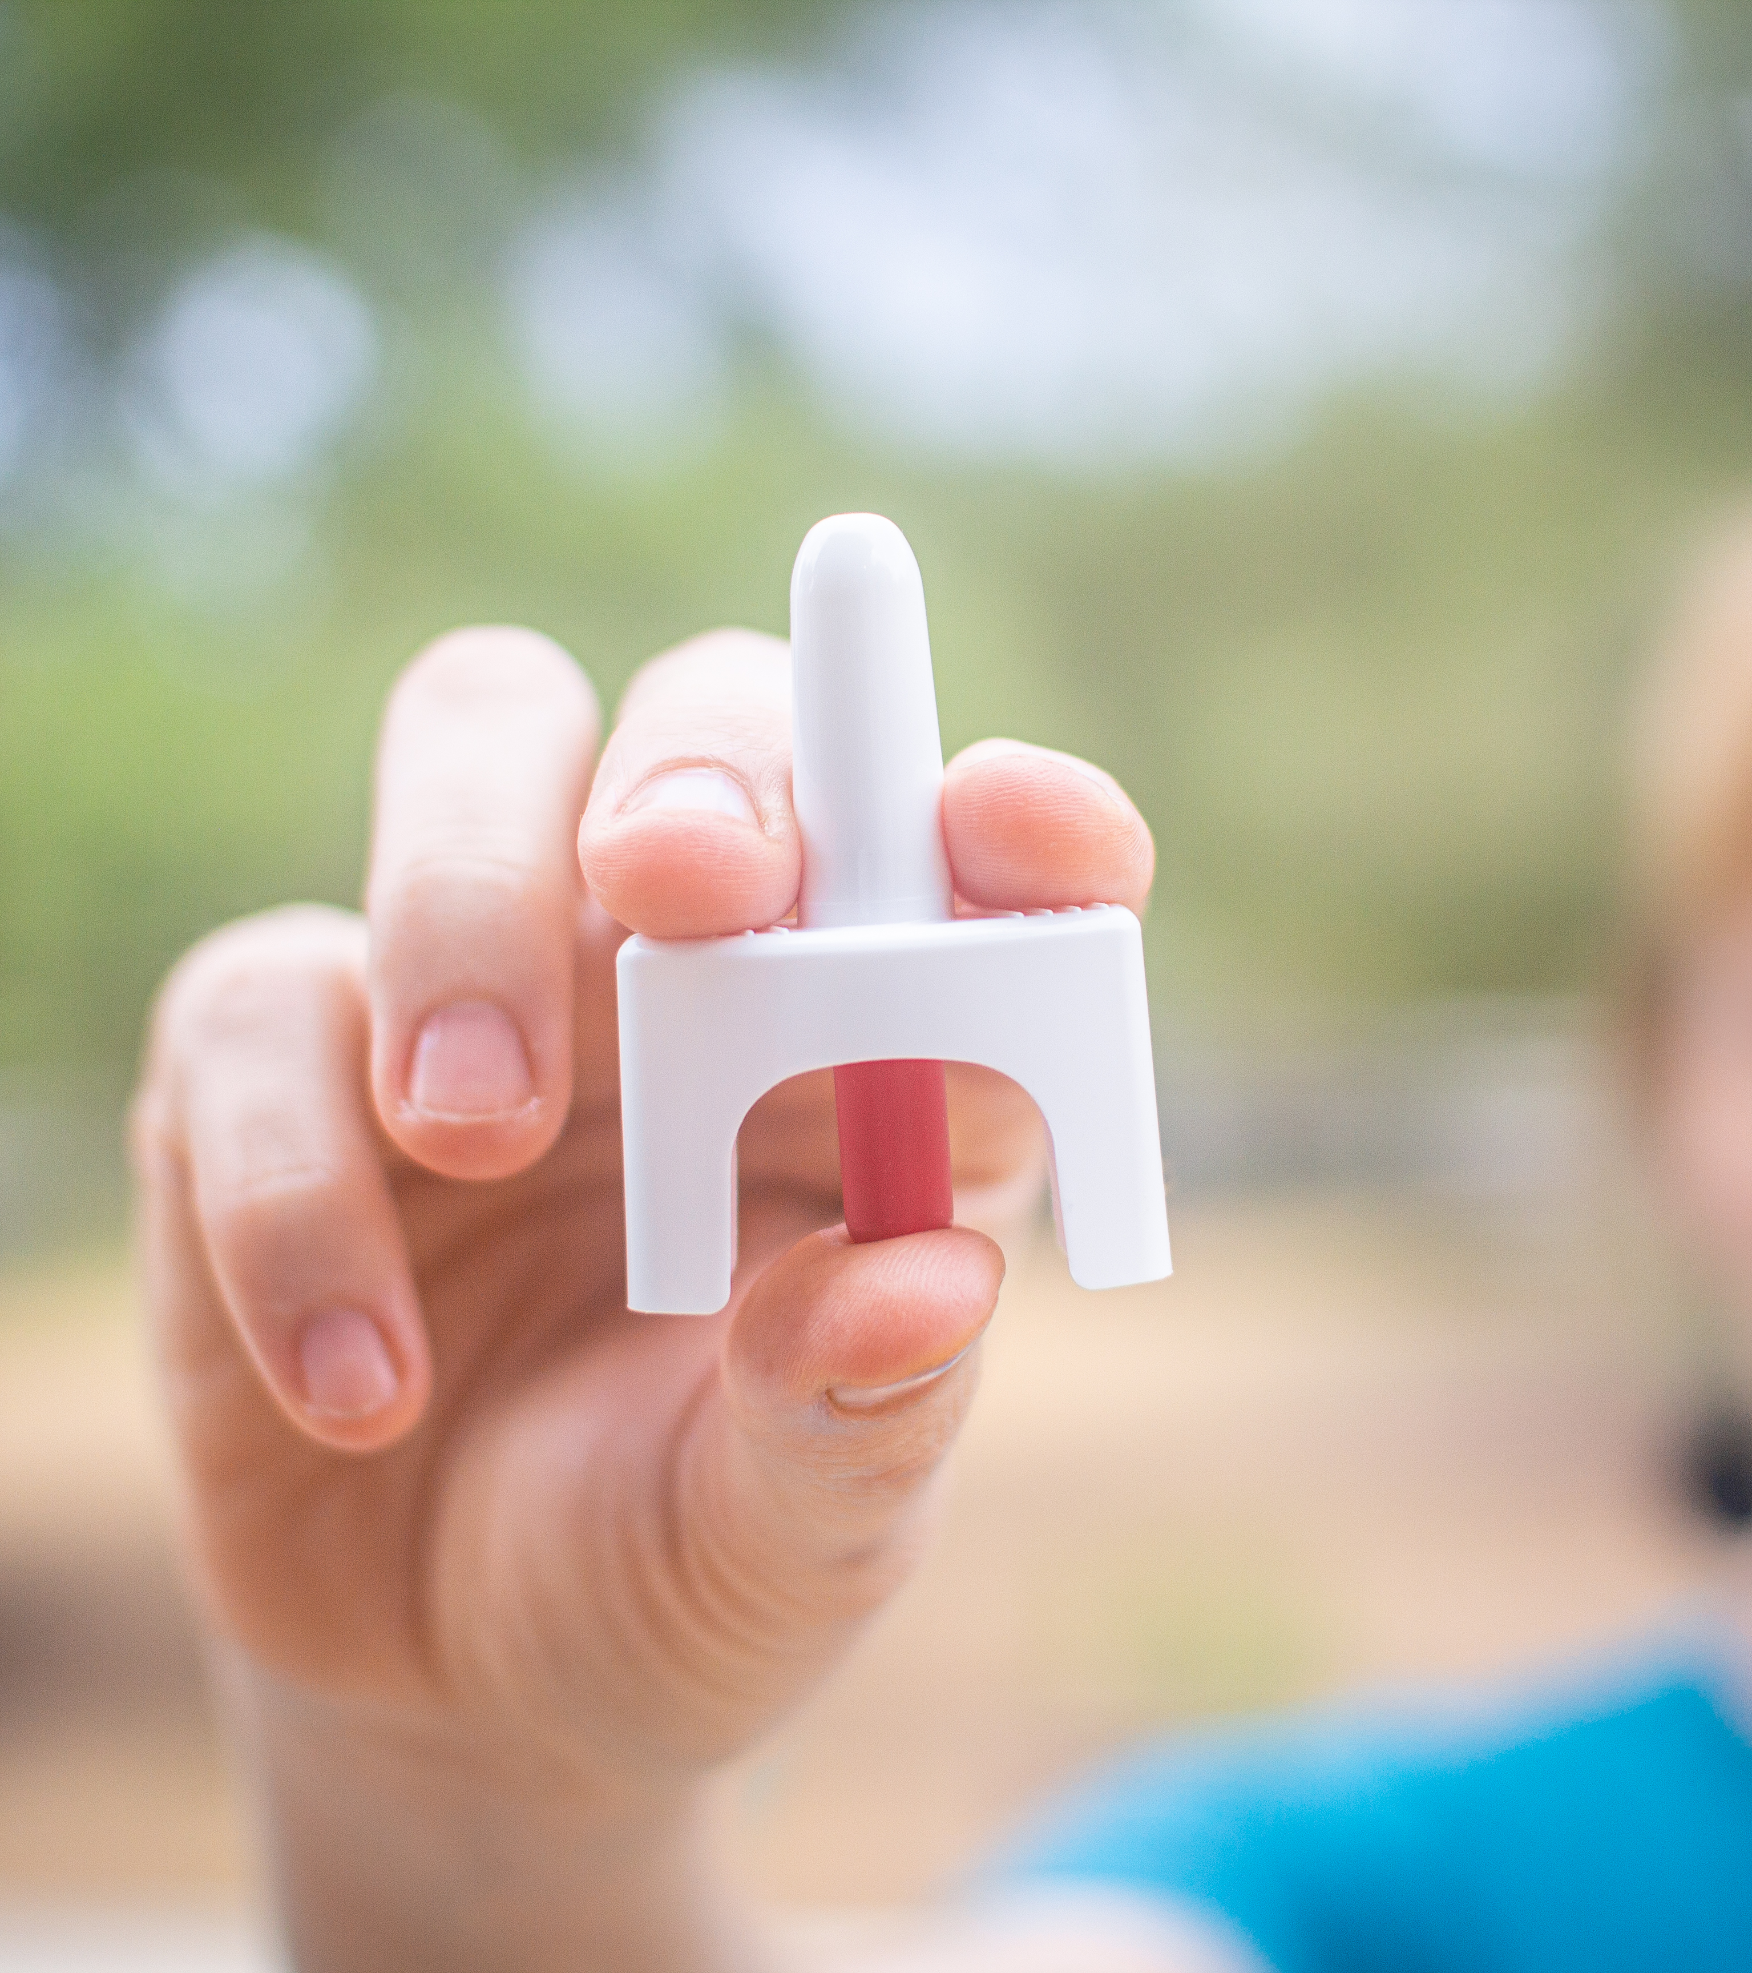
How to respond to an overdose
Call 911 right away
Try to wake the person up
Give naloxone, if available
Begin rescue breathing or CPR
Turn the person on their side to prevent choking
Stay with the person until emergency services arrive

Slide 17
Reasons Not to Misuse Opioids
04

Slide 18

Reasons Not to Misuse Opioids
Risk of Addiction and Overdose
Drugs and alcohol change parts of your brain that impact how you think and act.
The more you use them, the harder it can be to stop, even if you want to.
Opioids affect the part of the brain that controls breathing. A high dose of opioids can cause an overdose, slowing or stopping of breathing and sometimes resulting in death.
Future Plans
Don’t let drug and alcohol use change or control your plans for the future.

Slide 19
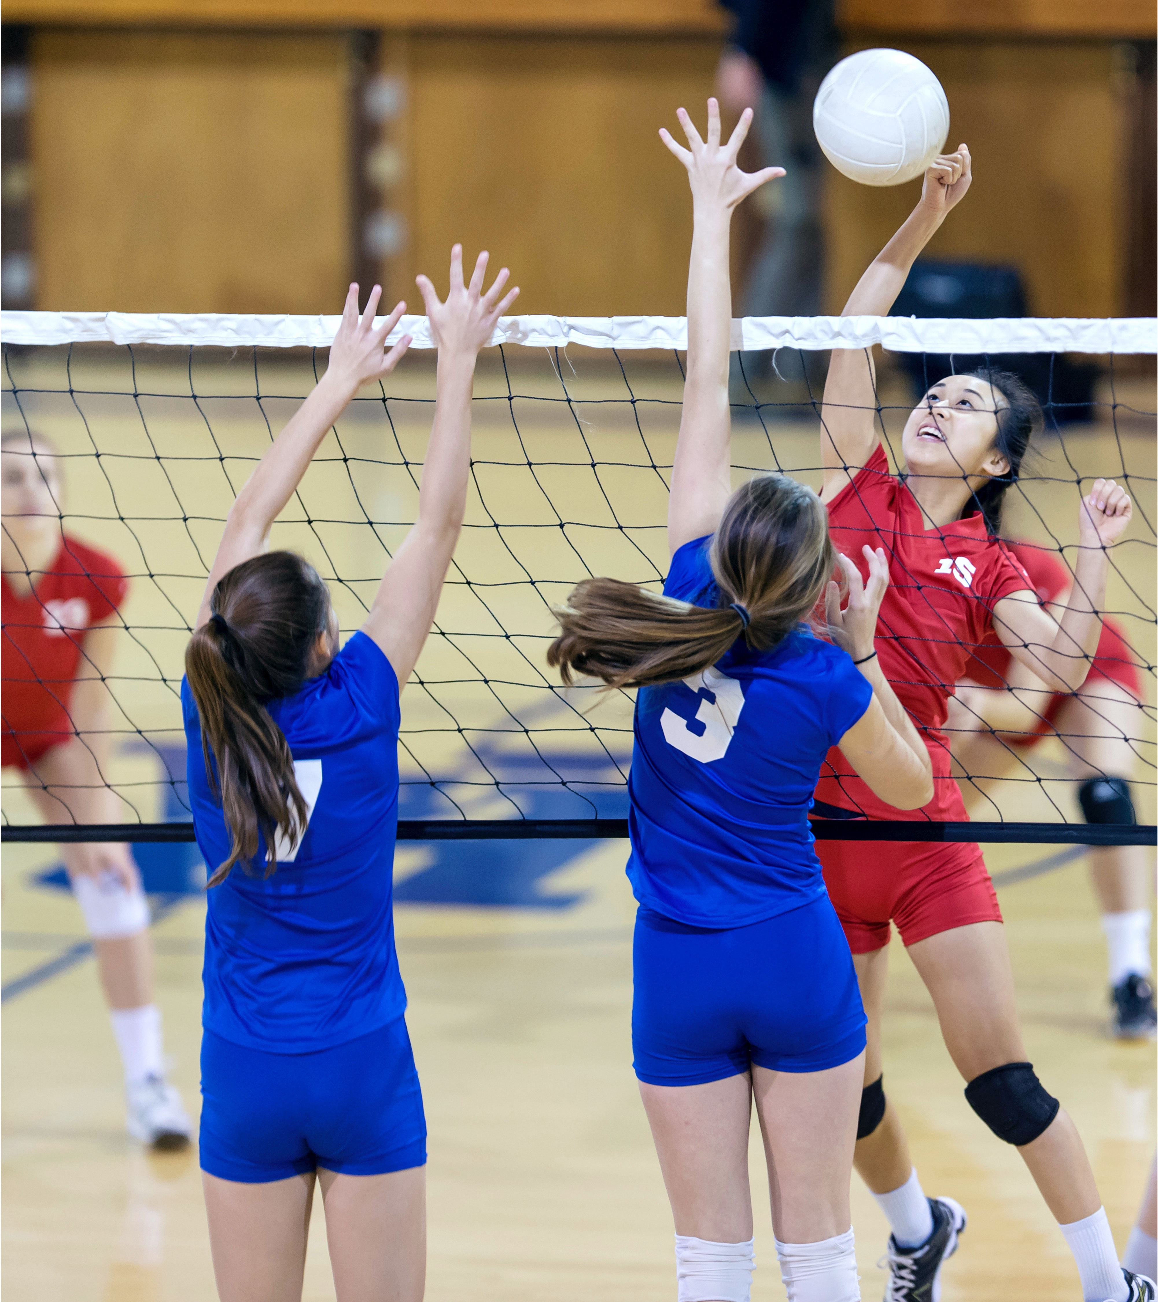
Reasons Not to Misuse Opioids
Activities and Hobbies
Participating in sports, music, hobbies or other activities can help you build friendships, stay in shape, get into college, receive scholarships and have fun.
Expense
Drugs and alcohol are not just illegal for people your age, they’re expensive.
They cost money you could be saving or spending on other things you want, need or enjoy.

Slide 20
Actions You Can Take
05

Slide 21

Lead By Example
Explore new ways of dealing with stress
Music, reading, writing, art, painting, sewing, cooking
Getting outdoors, spending time in nature, walking, exercising
Talking with friends you trust or just being by yourself, disconnected from social media
Caring for plants, decluttering or tidying up
Praying, meditating, wellness playlists

Slide 22
Lead By Example
Make your own personal commitment not to misuse opioids
Talk to your friends and encourage them not to misuse opioids
It doesn’t have to be an emotionally led topic
You can treat it like any other conversation you’d have with them
Further educate yourself about opioids
Further educate yourself about opioids
txopioidresponse.org
Find a local substance use prevention coalition near you: txsdy.org/coalitions/

Slide 23

Lead By Example
Find someone you can talk to
Leaning on adults you trust can help you navigate situations where:
You feel tempted or pressure to misuse opioids
You are struggling with opioid misuse

Slide 24
You respect yourself and want to make decisions that are best for you.
Trust yourself and your choice not to use drugs or alcohol.
PRESENTER CREDENTIALS AND CONTACT INFO

